Slide 1
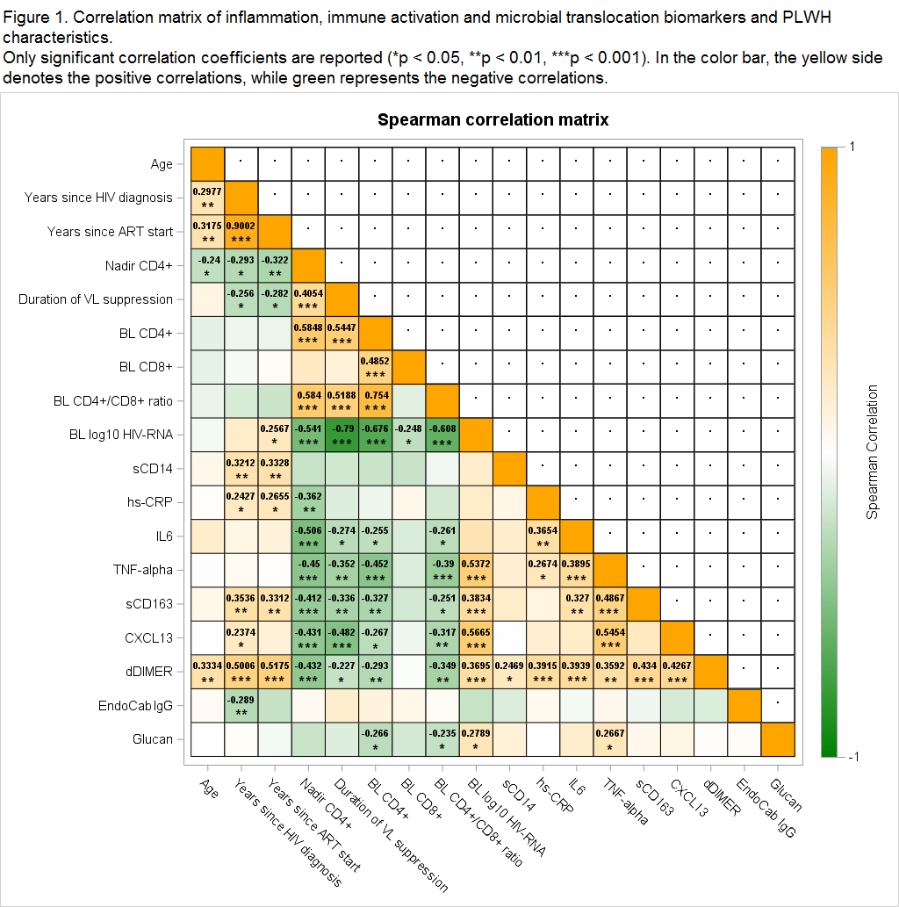
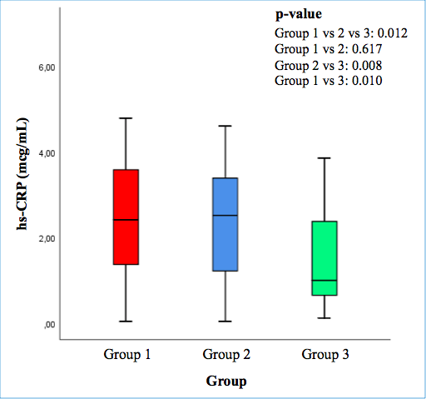
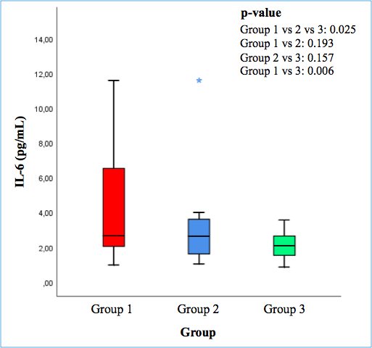
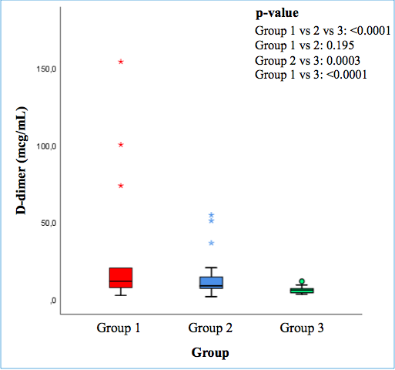
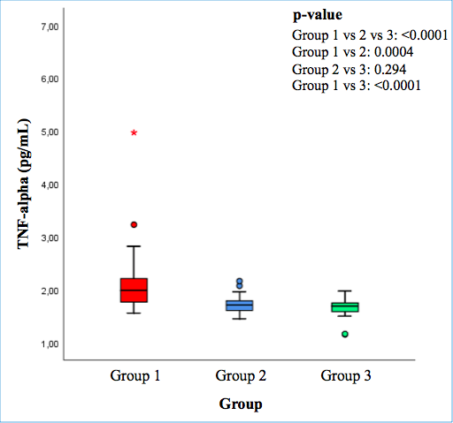
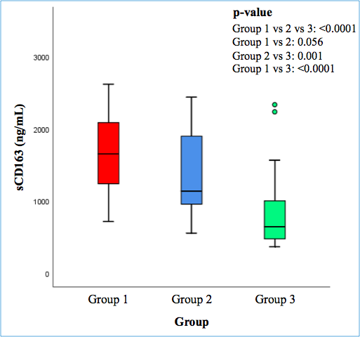
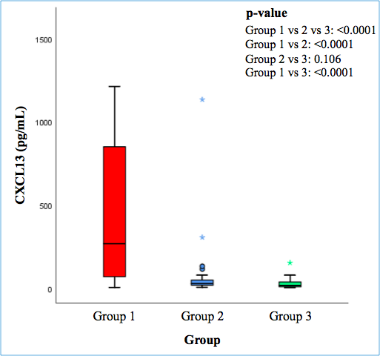
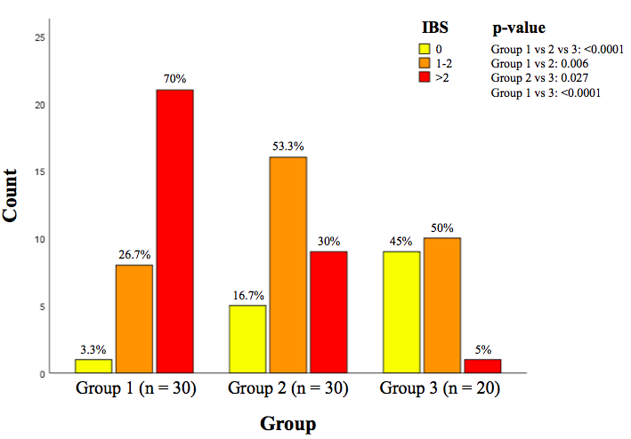
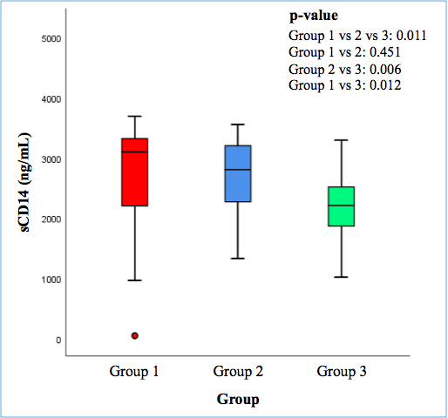
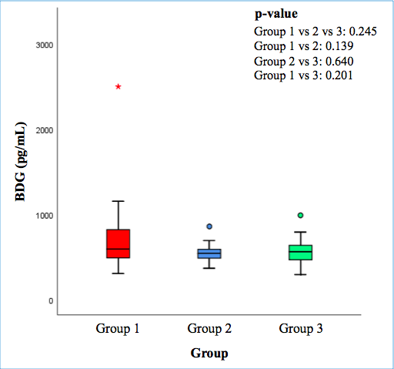
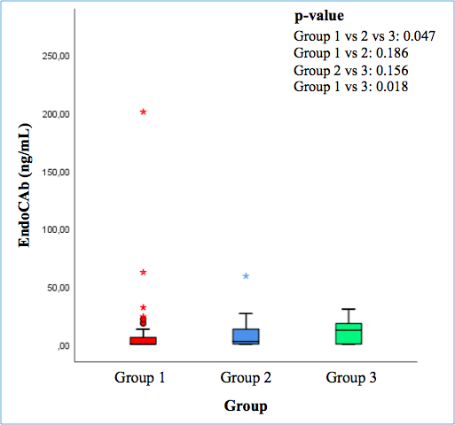
INFLAMMATION, IMMUNE ACTIVATION AND MICROBIAL TRANSLOCATION IN PERSONS LIVING
WITH FOUR-CLASS DRUG RESISTANT HIV: DATA FROM THE PRESTIGIO REGISTRY
PEB0250
V Spagnuolo^{1,2}, T Clemente¹, R Caccia², L Galli², A Poli², G Sterrantino³, R Gagliardini⁴, B Rossetti⁵, S Rusconi⁶, MM Santoro⁷, M Zazzi⁸, P Cinque², A Castagna^{1,2}, on behalf of the PRESTIGIO Study Group
1. Faculty of Medicine and Surgery, Vita-Salute San Raffaele University, Milan; 2. Infectious Diseases Unit, IRCCS San Raffaele Scientific Institute, Milan; 3. Department of Experimental and Clinical Medicine, University of Florence, Florence, Italy; 4. National Institute for Infectious Diseases L. Spallanzani, IRCCS, Rome, Italy; 5. Infectious Diseases Unit, Azienda Ospedaliero-Universitaria Senese, Siena, Italy; 6. Infectious Diseases Unit, DIBIC Luigi Sacco, University of Milan, Milano, Italy; 7. Department of Experimental Medicine, University of Rome "Tor Vergata", Rome, Italy; 8. Department of Medical Biotechnology, University of Siena, Siena, Italy
Contact Informations:
Vincenzo Spagnuolo MD
Infectious Diseases Unit,
IRCCS San Raffaele Scientific Institute, Milan, Italy
Phone; +390226437907
e.mail: spagnuolo.vincenzo@hsr.it
July 6-10, 2020
Background
Table 1. PLWH characteristics at the time of sampling
Figure 2. Correlation matrix of inflammation, immune activation and microbial translocation biomarlkers and PLWH characteristics. Only significant correlation coefficients are reported (*p<0.05; ** p< 0.01; *** p<0.001). In the color bar, the yellow side denotes the positive correlations, while green represents the negative correlations.
Four-class drug resistant (4DCR) persons living with HIV (PLWH) are a fragile population with a 22% probability of AIDS- or non-AIDS events or death for any cause over 48 months¹. No data on biomarkers of inflammation, immune activation and microbial translocation are available for this population.
Methods
Cross-sectional study on three different groups of PLWH on antiretroviral therapy (ART):
-4DCR (defined as harbouring a four-class drug resistant virus (NRTI, NNRTI, PI, INSTI)) with HIV-1 RNA ≥ 50 copies/mL (group-1; n=30);
-4DCR with HIV-RNA < 50 copies/mL (group-2; n=30);
- non-4DCR with HIV-RNA < 50 copies/mL (group-3; n=20).
Groups were matched by age (±5 years), sex, smoking habit.
Markers of inflammation (hs-CRP, IL-6, TNF-alpha, d-dimer), immune activation (sCD163 and CXCL13) and microbial translocation (sCD14, endotoxin core IgG (EndoCAb IgG) and 1-3-β-D-glucan (BDG)) were measured using specific ELISA kits. An inflammation burden score (IBS) was defined as the number of biomarkers with an abnormal level, including all the aforementioned markers. An abnormal biomarker level was defined as a value at or above the 75th percentile (elevated); for EndoCAb, abnormal level was defined as a value at or below the 25th percentile (reduced).
Linear correlations were assessed by Spearman correlation analysis.
Linear regression was fitted to estimate factors associated with IBS.
Figure 1. Plasma levels of inflammation (hs-CRP, IL-6, d-dimer, TNF-alpha), immune activation (sCD163 and CXCL13), and microbial translocation (sCD14,1-3-BDG and EndoCAb IgG) soluble biomarkers among the three different groups of PLWH
Results
Eighty subjects were evaluated: median age was 51.7 (IQR=45.9-55.2) years, 86% male, 60% smokers, on ART since 17.8 (IQR=8.0-23.7) years, 472 (IQR=237-766) CD4+cells/mm³; HIV-1 RNA was 3.78 (IQR=2.1-4.69) log₁₀copies/mL in group-1.
Patients characteristics among different groups are reported in table 1 and differences in biomarkers levels among groups are described in Figure 1.
Multiple correlations (Figure 2) were detected among inflammation, immune activation and microbial translocation biomarkers and patient characteristics.
Distribution of IBS and factors associated with IBS are reported in Figure 3 and Table 2, respectively.
Figure 3. IBS distribution in the three groups
Table 2. Linear regression analysis to estimate factors associated with IBS
Conclusion
PLWH harbouring a multi-drug resistant virus, also when virologically undetectable, showed a higher degree of inflammation (hs-CRP, d-dimer), immune activation (sCD163, CXCL13) and microbial translocation (sCD14), compared to the non-4DCR group. Four-class drug resistance, together with a higher HIV-RNA and a previous diagnosis of cancer were associated with an increased inflammatory status.
Group 1 = 4DCR-PLWH with HIV-1 RNA ≥50 copies/mL; Group 2 = 4DCR-PLWH with HIV-1 RNA <50 copies/mL; Group 3 = non-4DCR-PLWH with HIV-1 RNA <50 copies/mL.
Acknowledgments
References
The authors wish to thank the PRESTIGIO Study Group: STEERING COMMITTEE: Antonella Castagna (Coordinator), Nicola Gianotti, Laura Galli, Franco Maggiolo, Leonardo Calza, Emanuele Focà, Gaetana Sterrantino, Giovanni Cenderello, Antonio Di Biagio, Stefano Rusconi, Cristina Mussini, Marianna Menozzi, Andrea Antinori, Roberta Gagliardini, Stefano Bonora, Micol Ferrara, Maurizio Zazzi, Maria Santoro, Giulio Maria Corbelli.
VIROLOGY TEAM AND BIOLOGICAL BANK: Maurizio Zazzi, Maria Mercedes Santoro, Andrea Galli. STUDY COORDINATORS: Elisabetta Carini, Maria Rita Parisi. STATISTICAL AND MONITORING TEAM: Laura Galli, Andrea Poli, Alba Bigoloni. PARTICIPATING CENTERS: Ancona: Marcello Tavio, Luca Butini, Andrea Giacometti; Aviano: Emanuela Vaccher, Ferdinando Martellotta, Valentina Da Ros; Bari: Gioacchino Angarano, Annalisa Saracino, Flavia Balena; Bergamo: Franco Maggiolo, Laura Comi, Elisa Di Filippo, Daniela Valenti, Claudia Suardi, Barbara Mazzola; Bologna: Pierluigi Viale, Leonardo Calza, Elena Rosselli del Turco, Marta Vacas Ramirez; Brescia: Francesco Castelli, Emanuele Focà, Anna Celotti, Francesca Brognoli; Busto Arsizio: Guido Bonoldi, Barbara Menzaghi, Clara Abeli, Maddalena Farinazzo; Cagliari: Francesco Ortu, Marco Campus; Catania: Bruno Cacopardo, Maurizio Celesia; Cremona: Angelo Pan, Chiara Fornabaio; Firenze: Alessandro Bartoloni, Gaetana Sterrantino, Francesca Rinaldi, Susanna Giachè, Blanc Pierluigi, Francesca Vichi, Francesco Maria Fusco; Foggia: Teresa Santantonio, Sergio Ferrara, Serena Rita Bruno; Genova: Giovanni Cassola, Giovanni Cenderello, Feasi Marcello, Francesca Calautti, Matteo Bassetti, Antonio Di Biagio, Bianca Bruzzone; La Spezia: Stefania Artioli; Milano: Adriano Lazzarin, Antonella Castagna, Nicola Gianotti, Elisabetta Carini, Maria Rita Parisi, Laura Galli, Andrea Poli, Andrea Galli, Diana Canetti, Massimo Galli, Stefano Rusconi, Tiziana Formenti, Valentina Morena, Arianna Gabrieli, Antonella d'Arminio Monforte, Lidia Gazzola, Esther Merlini, Valentina Minieri, Andrea Gori, Alessandra Bandera, Valeria Pastore, Valentina Ferroni, Massimo Puoti, Cristina Moioli; Sara Vassalli; Modena: Cristina Mussini, Marianna Menozzi, Roncaglia Enrica, Nardini Giulia, Barbara Beghetto; Napoli: Elio Manzillo, Alfredo Franco; Padova: Anna Maria Cattelan, Serena Marinello, Silvia Cavinato, Annamaria Macario; Palermo: Antonio Cascio, Giovanni Mazzola; Parma: Anna Maria degli Antoni, Carlo Ferrari, Diletta Laccabue; Pavia: Gaetano Filice, Roberto Gulminetti, Layla Pagnucco, Annalia Asti; Perugia/Terni: Daniela Francisci, Pasticci, Elisabetta Schiaroli, Chiara Papalini, Francesca Italiani; Pistoia: Massimo Di Pietro; Reggio Emilia: Giacomo Magnani, Garlassi Elisa, Enrico Barchi, Romina Corsini; Roma: Andrea Antinori, Roberta Gagliardini, Alessandra Vergori, Stefania Cicalini, Giovanna Onnelli, Alberto Giannetti, Roberto Cauda, Arturo Ciccullo, Silvia La Monica, Vincenzo Vullo, Gabriella Dettorre, Eugenio Nelson Cavallari, Massimo Andreoni, Vincenzo Malagnino, Laura Ceccarelli; Rovigo: Filippo Viviani, Lolita Sasset; Sanremo: Chiara Dentone; Siena: Barbara Rossetti, Sara Modica, Valentina Borgo; Torino: Giovanni Di Perri, Stefano Bonora, Micol Ferrara, Chiara Carcieri; Verona: Marina Malena, Marta Fiscon, Barbara Padovani; Trieste: Roberto Luzzati, Sandro Centonze, Romina Valentinotti.
1. Parisi MR et al. Burden of disease in PLWH harbouring a 4-class drug resistant virus: data from PRESTIGIO Registry. Italian Conference on AIDS and Antiviral Research. June 5-7, 2019, Milan, Italy.

